Slide 1


UNIVERSITY OF BASRA
COLLEGE OF MEDICINE
DEPARTMENT OF PATHOLOGY AND FORENSIC Medicine
Microcytic anemia
Dr. Ala’a A.Razak Abood
Iraqi Board of Haematopathology

Slide 2
Objectives:
1- Define microcytic anemia and give differential diagnosis of microcytosis.
2- Iron deficiency anemia:
- discuss the normal regulation of iron absorption
- identify the pathogenesis of iron deficiency anemia and the underlying causes.
- clinical features of iron deficiency.
- laboratory findings in such case.
3- Define anemia of chronic disorders, the underlying causes and the pathogenesis of this anemia.
4- Sideroblastic anemia: its classification and its pathogenesis.

Slide 3
Definition:
Microcytic hypochromic anaemia is a morphological description of a type of anemia in which the two red cell indices, mean corpuscular volume (MCV) and mean corpuscular haemoglobin (MCH), are reduced and the blood film shows small (microcytic) and pale (hypochromic) red cells.

Slide 4
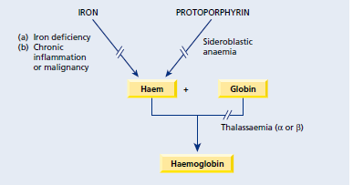
Differential diagnosis:

Slide 5
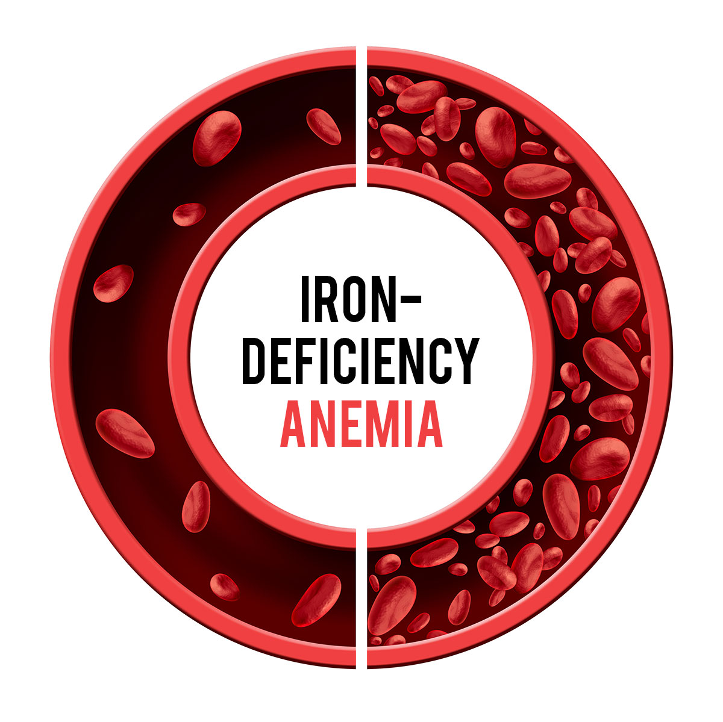

Slide 6
The regulation of iron absorption

Slide 7
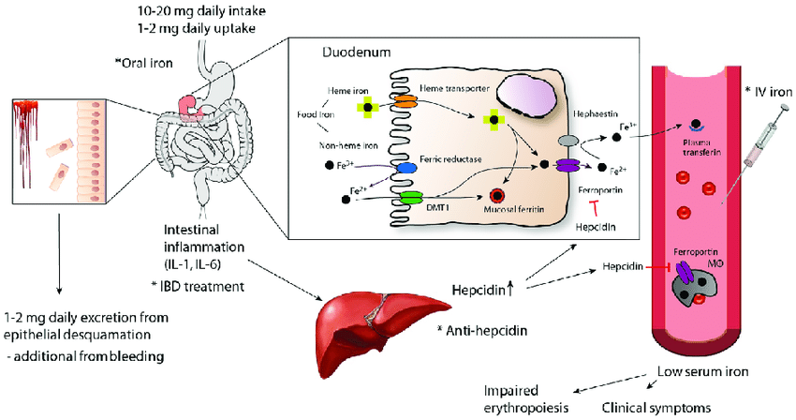
Pathogenesis of iron deficiency anemia:

Slide 8
Causes of Iron deficiency:

Slide 9
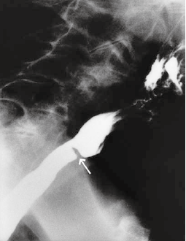
Clinical features of Iron deficiency:

Slide 10
Lab findings of Iron deficiency:
Red cell indices and blood film
The blood film shows hypochromic microcytic cells with occasional target cells and pencil – shaped poikilocytes.

Slide 11
Bone marrow iron
In iron deficiency anaemia there is a complete absence of iron from stores (macrophages) and from developing erythroblasts.
The erythroblasts are small and have a ragged cytoplasm.
Normal B.M iron store
Deficient iron stores in B.M

Slide 12
Serum iron and total iron - binding capacity
The serum iron falls and
total iron - binding capacity (TIBC) rises.
Serum ferritin
- In iron deficiency anaemia the serum ferritin is very low.

Slide 13

Enumerate causes of raised serum ferritin

Slide 14
Investigation of the cause of iron deficiency

Slide 15
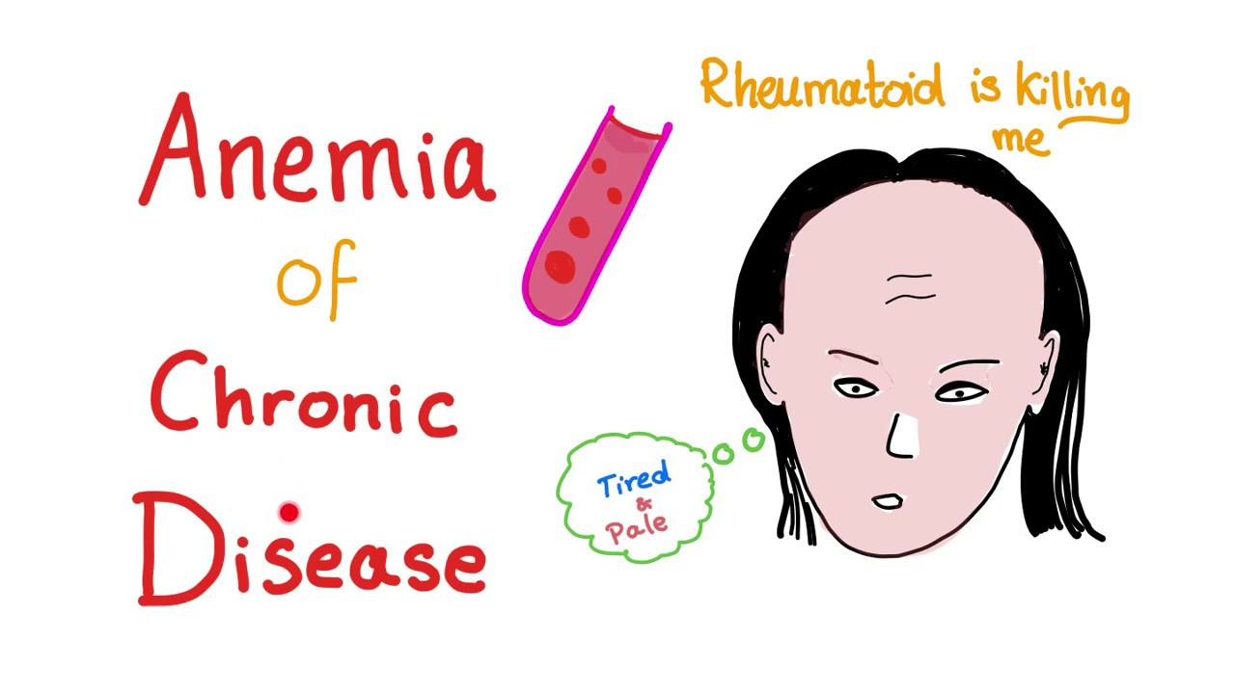

Slide 16
Definition:
One of the most common anaemias occurs in patients with a variety of chronic inflammatory and malignant diseases.

Slide 17
Causes:

Slide 18
Pathogenesis:
decreased release of iron from macrophages to plasma because of raised serum hepcidin levels,
reduced red cell lifespan
and an inadequate erythropoietin response to anaemia caused by the effects of cytokines such as IL - 1 and tumour necrosis factor (TNF) on erythropoiesis.

Slide 19
Characteristic features:
1 - Normochromic, normocytic or mildly hypochromic (MCV rarely < 75 fL) indices and red cell morphology.
2 - Mild and non - progressive anaemia (haemoglobin rarely < 9.0 g/dL).
3 - Both the serum iron and TIBC are reduced.
4 - The serum ferritin is normal or raised

Slide 20
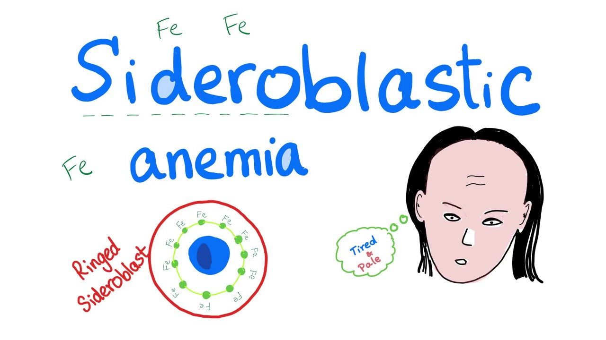

Slide 21
Sideroblastic anemia:
- This is a refractory anaemia defined by the presence of many pathological ring sideroblasts in the bone
marrow.
- These are abnormal erythroblasts containing numerous iron granules arranged in a ring or collar around the nucleus instead of the few randomly distributed iron granules seen when normal erythroblasts are stained for iron.

Slide 22
Classification:
Hereditary
Sideroblastic anemia
Acquired

Slide 23
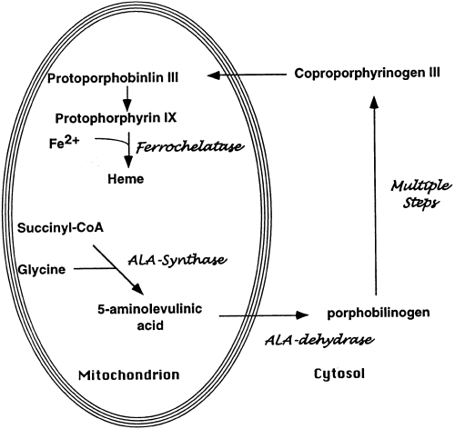
Pathogenesis:

Slide 25


